Slide 1
Group 6 Progress Report
Nathan R, Dominic O, Drew F, Jalen G, Michael M, Daniel A

Slide 2

Work Contributions
Daniel: Made game demo
Dominic: Made charts (use cases and sequence diagrams)
Drew: Requirements, use case charts, Interface Diagram
Jalen: Use cases’ written descriptions
Michael: Preliminary research and website backend design
Nathan: High-Level Architecture
Note: While the entire group contributed to every document, we attributed them to the people who actually created them. We also didn’t mention the SPMP because everyone contributed to it in roughly equal measure.

Slide 3
Work Plans
Nathan plans on implementing social media connection to the website
Dominic will implement the location finder feature for nearby fitness opportunities
Michael and Drew are managing backend development, implementing database features
Daniel is focusing on the UI including the game and doing the web design along with Drew
Jalen will be helping Daniel with game design and debugging the website
To help manage goals and keep the team on task, we will create a Trello board to be updated on a consistent basis

Slide 4
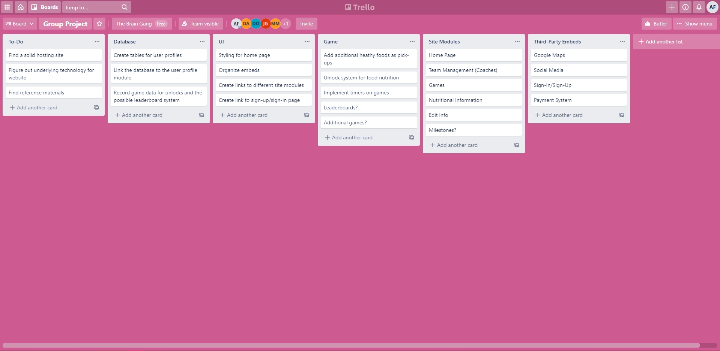

Slide 5
Web Design
The website will be built from scratch
We will host it on InfinityFree which allows us to upload our raw code and database files without any managed aspects from the hosting service, except for hosting the website online and proper tool handling
Each significant feature will have its own page, aside from the social media integration which will be included on the home page
There will be an SQL database used for storing any necessary information for the website, the game, and potentially the login information

Slide 6
Account Management
Different users and role account types (athlete, coach, parent) will have different functions.
Student | Parent | Coach
Game Access | Particular Student Info | All Student Info
Social Media | Contact Information | Remove/Add Students
GPS Info | GPS Info | GPS Info
 | Social Media | Team Profiles

Slide 7
SQL Database
We will have an SQL database built into the backend of the website and used to store various pieces of information such as:
Game information
Login details
Student details
Parent, coach, and child account relationships

Slide 8
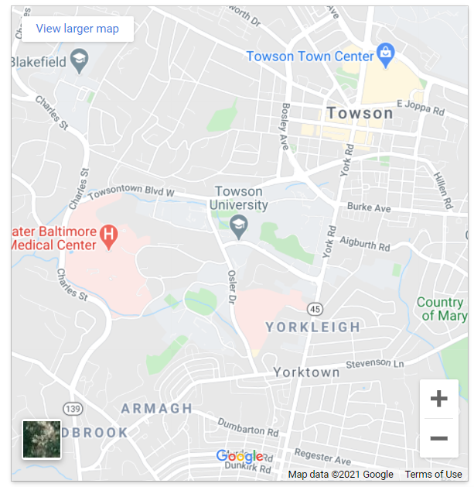
GPS Gym Locator
Google Maps API
Map embedded into webpage
Local gyms will be shown

Slide 9
Payment Processing
Stripe will be our payment processing platform
Stripe includes a variety of different options for online payments including subscription based payment processing
Using their API and documentation, we will direct all payments to be handled by their pre-existing and secure portals that will be integrated into our payment page

Slide 10
Game Design
We’ve created a very rough demo of the project based off online video tutorials.
Objective
Gameplay is based on an in-game character. The character is controlled by the player and has a set time limit to try to collect various foods that pop up around her/him.
When enough of certain food types is collected, general nutritional information about the food will be displayed on screen. Users will be able to learn about what foods are and aren’t good for them.
The user will have 30 seconds to collect as many healthy foods as possible. The more high scores the user earns, the more information they will unlock.

Slide 11
Game Progress
We have basic functionality completed for the game. There is a player character able to move around using the mouse cursor. At this stage of development, the character is only collecting circles that float in and out of the screen, each time gaining one point to the score counter when one is collected.
Features planned as of now are:
High score leaderboard
In-game timer
Different point values for foods eaten
Nutritional pop-ups

Slide 12
Game Demo

Slide 13





Tools and Languages
Main Languages: Javascript, HTML, CSS
Javascript Runtime Environment: NodeJS
Database: SQLite, SQL
IDE: Visual Studio Code
Project Management: Trello
Project Repository: GitHub
Website Hosting: InfinityFree

Slide 14
THANK YOU

Slide 15
Resources
JavaScript 2D Game Tutorial - https://www.youtube.com/watch?v=jl29qI62XPg
Website Hosting - https://infinityfree.net/
Trello - https://trello.com/
Stripe - https://stripe.com/
Github - https://github.com/
Node JS - https://nodejs.org/en/
Visual Studio Code - https://code.visualstudio.com/
Google Maps API - https://developers.google.com/maps/documentation/embed/map-generator#cleaning-up

